Slide 1
Boolean Algebra
Chapter 12
With Question/Answer Animations
© 2019 McGraw-Hill Education. All rights reserved. Authorized only for instructor use in the classroom. No reproduction or further distribution permitted without the prior written consent of McGraw-Hill Education.

Slide 2

Chapter Summary
Boolean Functions
Representing Boolean Functions
Logic Gates
Minimization of Circuits (not currently included in overheads)
Claude Shannon (1916 - 2001)

Slide 3
Boolean Functions
Section 12.1

Slide 4
Section Summary 1
Introduction to Boolean Algebra
Boolean Expressions and Boolean Functions
Identities of Boolean Algebra
Duality
The Abstract Definition of a Boolean Algebra

Slide 5
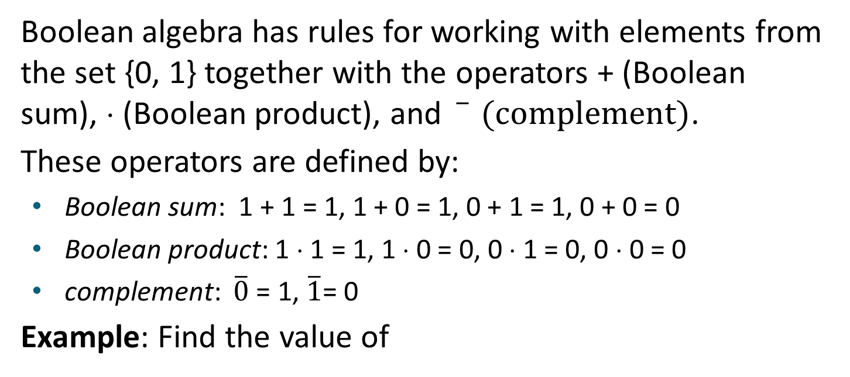
Introduction to Boolean Algebra
Boolean algebra has rules for working with elements from the set {0, 1} together with the operators + (Boolean sum), ⋅ (Boolean product), and $\overline{ } (complement)$.
These operators are defined by:
Boolean sum: 1 + 1 = 1, 1 + 0 = 1, 0 + 1 = 1, 0 + 0 = 0
Boolean product: 1 ⋅ 1 = 1, 1 ⋅ 0 = 0, 0 ⋅ 1 = 0, 0 ⋅ 0 = 0
complement: $\overline{0}$ = 1, $\overline{1}$= 0
Example: Find the value of
Solution :

Slide 6
Boolean Expressions and Boolean Functions 1
Definition: Let B = {0, 1}. Then B^{n} = {(x₁, x₂, …, x_{n}) | x_{i} ∈ B for 1 ≤ i ≤ n } is the set of all possible n-tuples of 0s and 1s. The variable x is called a Boolean variable if it assumes values only from B, that is, if its only possible values are 0 and 1. A function from B^{n} to B is called a Boolean function of degree n.
Example: The function F(x, y) = x from the set of ordered pairs of Boolean variables to the set {0, 1} is a Boolean function of degree 2.
TABLE 1
x | y | F(x, y)
1 1 0 0 | 1 0 1 0 | 1 0 0 1

Slide 7
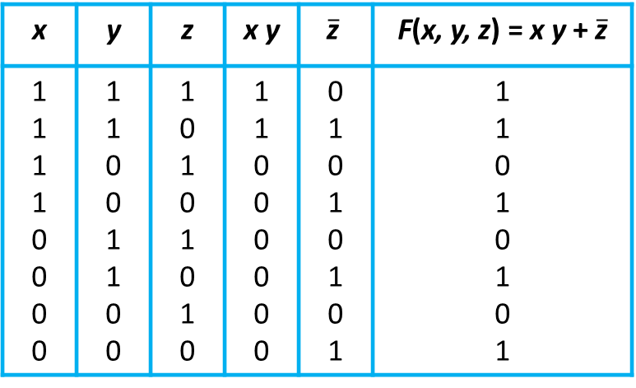
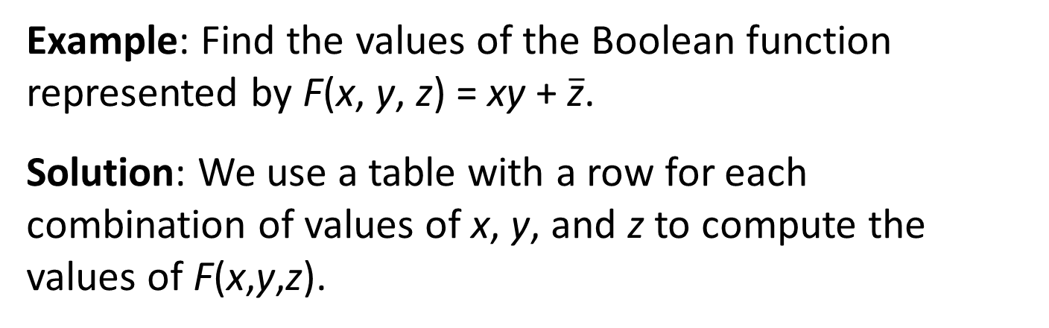
Boolean Expressions and Boolean Functions 2
Example: Find the values of the Boolean function represented by F(x, y, z) = xy + $\overline{\text{z}}$.
Solution: We use a table with a row for each combination of values of x, y, and z to compute the values of F(x,y,z).
TABLE 2
x | y | z | x y | $$\overline{\text{z}}$$ | F(x, y, z) = x y + $\overline{\text{z}}$
1 1 1 1 0 0 0 0 | 1 1 0 0 1 1 0 0 | 1 0 1 0 1 0 1 0 | 1 1 0 0 0 0 0 0 | 0 1 0 1 0 1 0 1 | 1 1 0 1 0 1 0 1

Slide 8
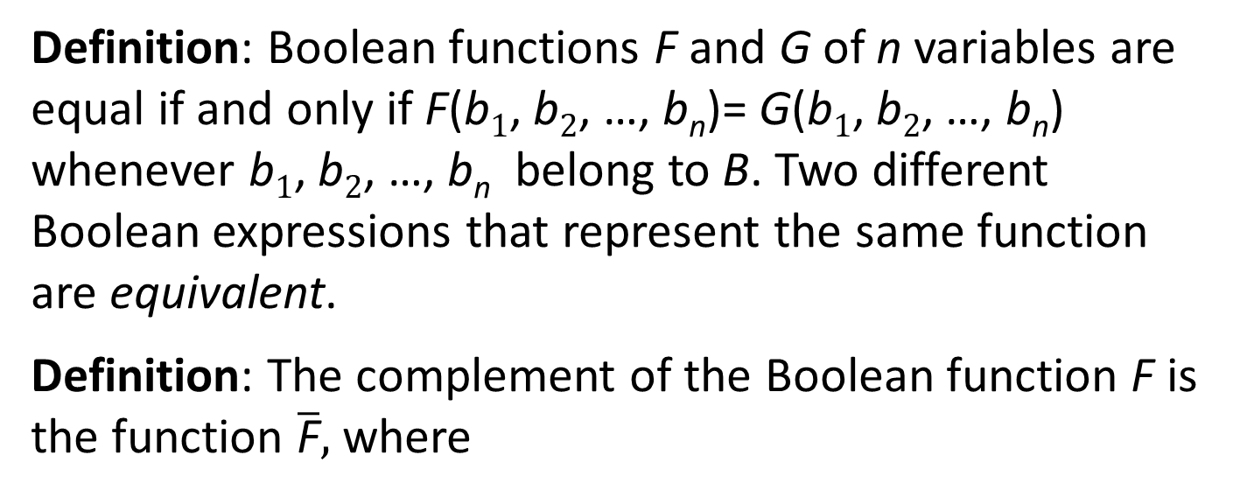
Boolean Expressions and Boolean Functions 3
Definition: Boolean functions F and G of n variables are equal if and only if F(b₁, b₂, …, b_{n})= G(b₁, b₂, …, b_{n}) whenever b₁, b₂, …, b_{n} belong to B. Two different Boolean expressions that represent the same function are equivalent.
Definition: The complement of the Boolean function F is the function $\overline{\text{F}},$ where
Definition: Let F and G be Boolean functions of degree n. The Boolean sum F + G and the Boolean product FG are defined by

Slide 9
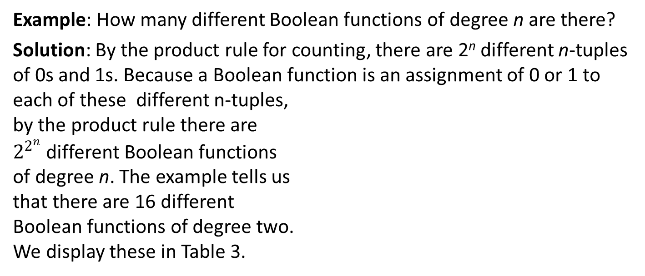
Boolean Functions
Example: How many different Boolean functions of degree n are there?
Solution: By the product rule for counting, there are 2^{n} different n-tuples of 0s and 1s. Because a Boolean function is an assignment of 0 or 1 to each of these different n-tuples, by the product rule there are $2^{2^{n}}$ different Boolean functions of degree n. The example tells us that there are 16 different Boolean functions of degree two. We display these in Table 3.
TABLE 4 The Number of Boolean Functions of Degree n.
Degree | Number
1 2 3 4 5 6 | 4 16 256 65,536 4,294,967,296 18,446,744,073,709,551,616
TABLE 3 The 16 Boolean Functions of Degree Two.
x | y | F₁ | F₂ | F₃ | F₄ | F₅ | F₆ | F₇ | F₈ | F₉ | F₁₀ | F₁₁ | F₁₂ | F₁₃ | F₁₄ | F₁₅ | F₁₆
1 1 0 0 | 1 0 1 0 | 1 1 1 1 | 1 1 1 0 | 1 1 0 1 | 1 1 0 0 | 1 0 1 1 | 1 0 1 0 | 1 0 0 1 | 1 0 0 0 | 0 1 1 1 | 0 1 1 0 | 0 1 0 1 | 0 1 0 0 | 0 0 1 1 | 0 0 1 0 | 0 0 0 1 | 0 0 0 0

Slide 10
Identities of Boolean Algebra 1
TABLE 5 Boolean Identities.
Identity | Name
 | Law of the double complement
 | Idempotent laws
 | Identity laws
 | Domination laws
 | Commutative laws
 | Associative laws
 | Distributive laws
 | De Morgan’s laws
 | Absorption laws
 | Unit property
 | Zero property
Each identity can be proved using a table.
All identities in Table 5, except for the first and the last two come in pairs. Each element of the pair is the dual of the other (obtained by switching Boolean sums and Boolean products and 0’s and 1’s.
The Boolean identities correspond to the identities of propositional logic (Section 1.3) and the set identities (Section 2.2).

Slide 11
Identities of Boolean Algebra 2
Example: Show that the distributive law x(y + z) = xy + xz is valid.
Solution: We show that both sides of this identity always take the same value by constructing this table.
TABLE 6 Verifying One of the Distributive Laws.
x | y | z | Y+z | xy | xz | x(y + z) | Xy + xz
1 1 1 1 0 0 0 0 | 1 1 0 0 1 1 0 0 | 1 0 1 0 1 0 1 0 | 1 1 1 0 1 1 1 0 | 1 1 0 0 0 0 0 0 | 1 0 1 0 0 0 0 0 | 1 1 1 0 0 0 0 0 | 1 1 1 0 0 0 0 0

Slide 12
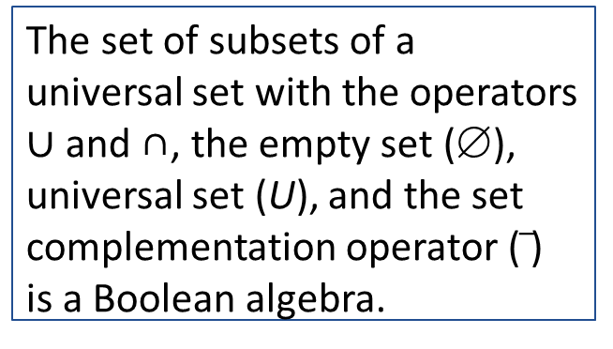
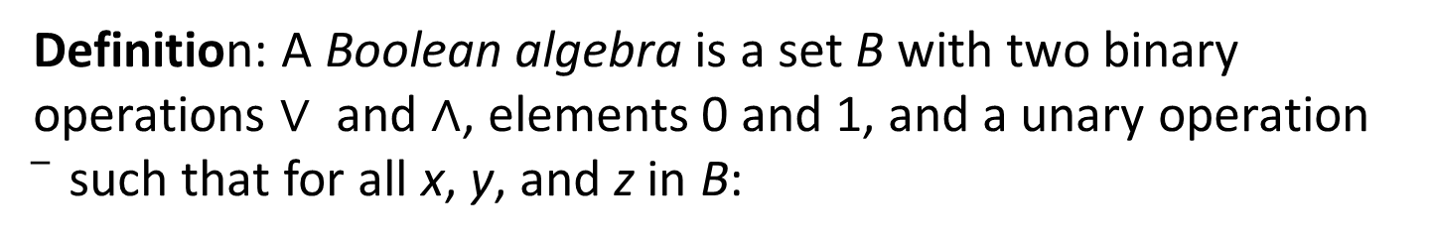
Formal Definition of a Boolean Algebra
Definition: A Boolean algebra is a set B with two binary operations ∨ and ∧, elements 0 and 1, and a unary operation such that for all x, y, and z in B:
The set of propositional variables with the operators ∧ and ∨, elements T and F, and the negation operator ¬ is a Boolean algebra.
identity laws
complement laws
associative laws
The set of subsets of a universal set with the operators ∪ and ∩, the empty set (∅), universal set (U), and the set complementation operator ( ) is a Boolean algebra.
commutative laws
distributive laws

Slide 13
Representing Boolean Functions
Section 12.2

Slide 14
Section Summary 2
Sum-of-Products Expansions
Functional Completeness

Slide 15
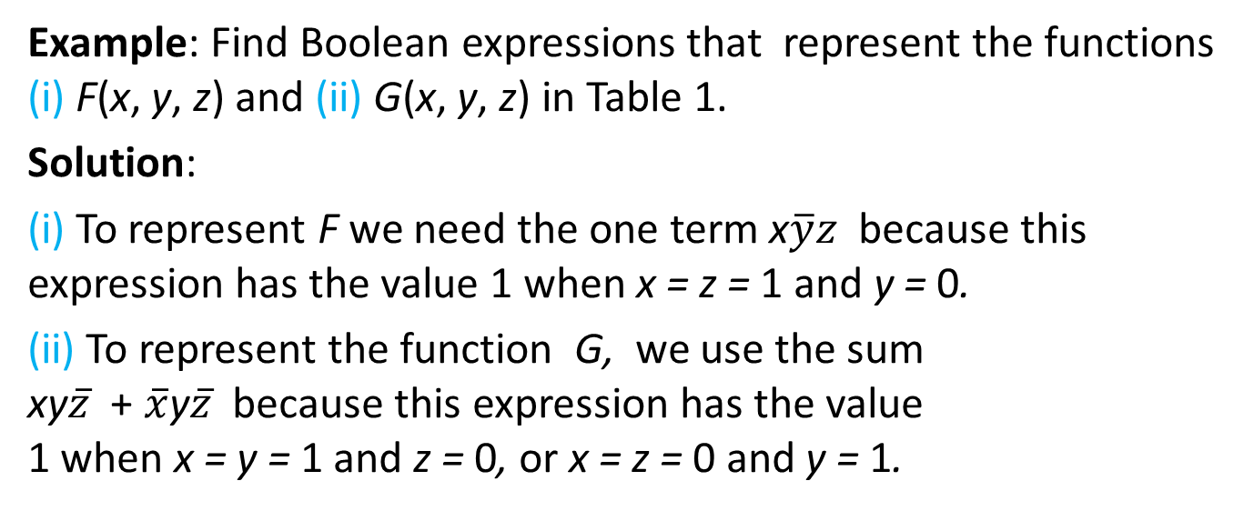
Sum-of-Products Expansion 1
Example: Find Boolean expressions that represent the functions (i) F(x, y, z) and (ii) G(x, y, z) in Table 1.
Solution:
(i) To represent F we need the one term x$\overline{y}z$ because this expression has the value 1 when x = z = 1 and y = 0.
(ii) To represent the function G, we use the sum xy$\overline{z}$ + $\overline{x}$y$\overline{z}$ because this expression has the value 1 when x = y = 1 and z = 0, or x = z = 0 and y = 1.
TABLE 1
x | y | z | F | G
1 1 1 1 0 0 0 0 | 1 1 0 0 1 1 0 0 | 1 0 1 0 1 0 1 0 | 0 0 1 0 0 0 0 0 | 0 1 0 0 0 1 0 0
The general principle is that each combination of values of the variables for which the function has the value 1 requires a term in the Boolean sum that is the Boolean product of the variables or their complements.

Slide 16
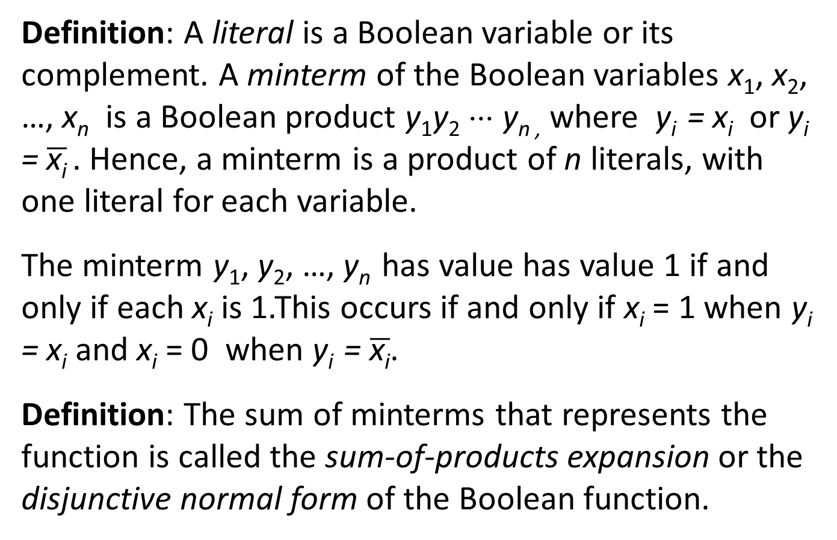
Sum-of-Products Expansion 2
Definition: A literal is a Boolean variable or its complement. A minterm of the Boolean variables x₁, x₂, …, x_{n} is a Boolean product y₁y₂ ⋅⋅⋅ y_{n ,} where y_{i} = x_{i} or y_{i} = $\overline{\text{x}\text{i}}$ . Hence, a minterm is a product of n literals, with one literal for each variable.
The minterm y₁, y₂, …, y_{n} has value has value 1 if and only if each x_{i} is 1.This occurs if and only if x_{i} = 1 when y_{i} = x_{i} and x_{i} = 0 when y_{i} = $\overline{\text{x}\text{i}}$.
Definition: The sum of minterms that represents the function is called the sum-of-products expansion or the disjunctive normal form of the Boolean function.

Slide 17
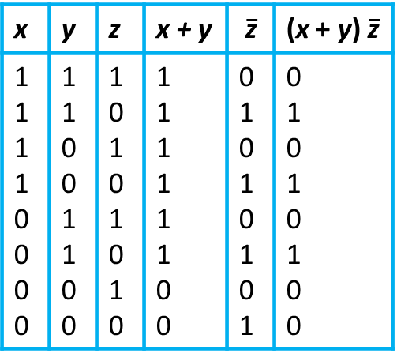
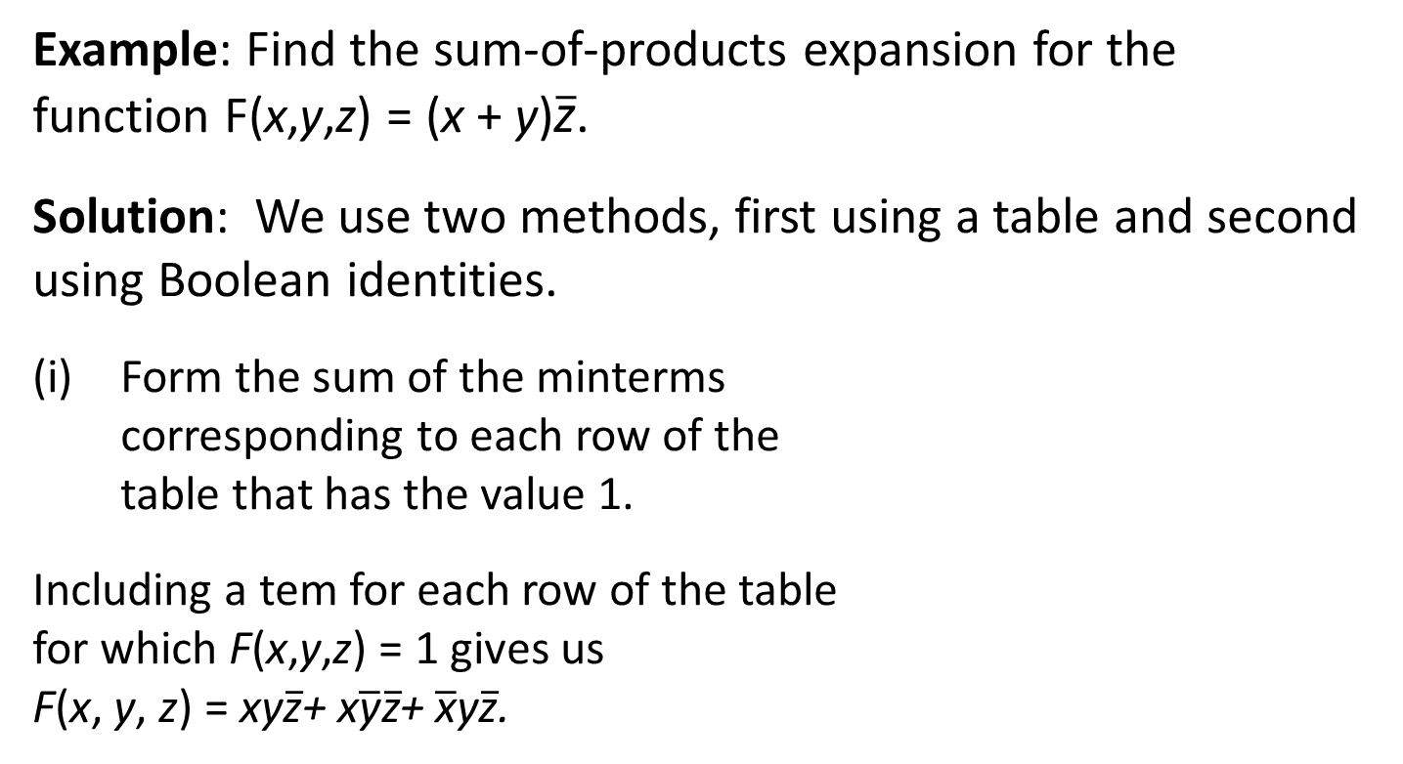
Sum-of-Products Expansion 3
Example: Find the sum-of-products expansion for the function F(x,y,z) = (x + y)$\overline{\text{z}}$.
Solution: We use two methods, first using a table and second using Boolean identities.
Form the sum of the minterms corresponding to each row of the table that has the value 1.
Including a tem for each row of the table for which F(x,y,z) = 1 gives us F(x, y, z) = xy$\overline{\text{z}}$+ x$\overline{\text{y}}\overline{\text{z}}$+ $\overline{\text{x}}$y$\overline{\text{z}}$.
TABLE 2
x | y | z | x + y | $$\overline{\text{z}}$$ | (x + y) $\overline{\text{z}}$
1 1 1 1 0 0 0 0 | 1 1 0 0 1 1 0 0 | 1 0 1 0 1 0 1 0 | 1 1 1 1 1 1 0 0 | 0 1 0 1 0 1 0 1 | 0 1 0 1 0 1 0 0

Slide 18
Sum-of-Products Expansion 4
We now use Boolean identities to find the disjunctive normal form of F(x,y,z):

Slide 19
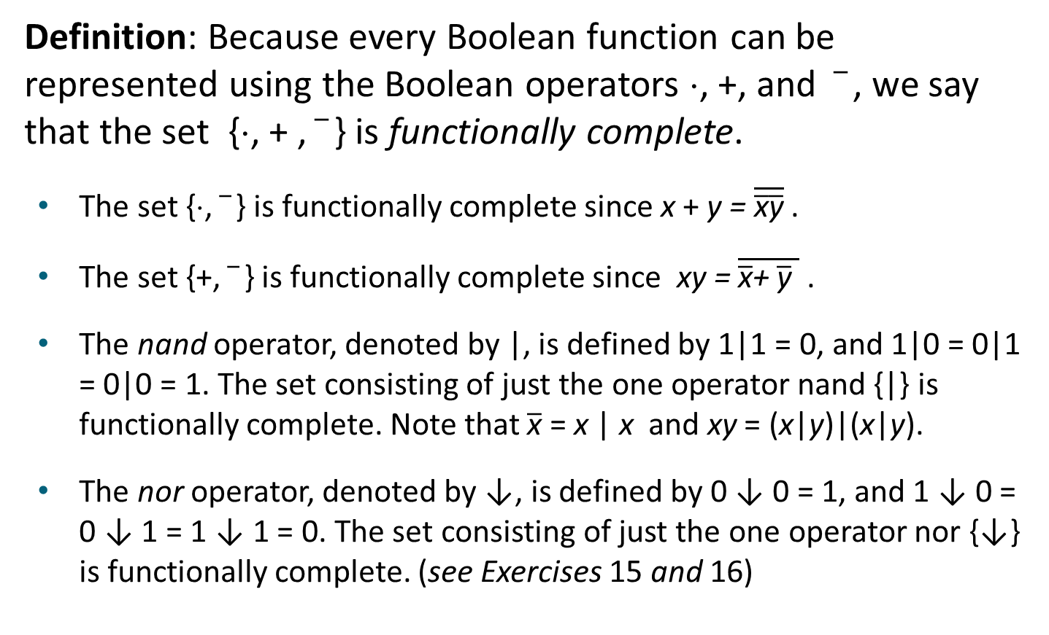
Functional Completeness
Definition: Because every Boolean function can be represented using the Boolean operators ⋅, +, and , we say that the set {⋅, + , } is functionally complete.
The set {⋅, } is functionally complete since x + y = $\overline{\overline{\text{x}}\overline{\text{y}}}$ .
The set {+, } is functionally complete since xy = $\overline{\overline{\text{x}}\text{+ }\overline{\text{y}} }$ .
The nand operator, denoted by |, is defined by 1|1 = 0, and 1|0 = 0|1 = 0|0 = 1. The set consisting of just the one operator nand {|} is functionally complete. Note that $\overline{\text{x}}$ = x | x and xy = (x|y)|(x|y).
The nor operator, denoted by ↓, is defined by 0 ↓ 0 = 1, and 1 ↓ 0 = 0 ↓ 1 = 1 ↓ 1 = 0. The set consisting of just the one operator nor {↓} is functionally complete. (see Exercises 15 and 16)

Slide 20
Logic Gates
Section 12.3

Slide 21
Section Summary 3
Logic Gates
Combinations of Gates
Examples of Circuits

Slide 22


Logic Gates
We construct circuits using gates, which take as input the values of two or more Boolean variables and produce one or more bits as output, and inverters, which take the value of a Boolean variable as input and produce the complement of this value as output.
Jump to long description

Slide 23
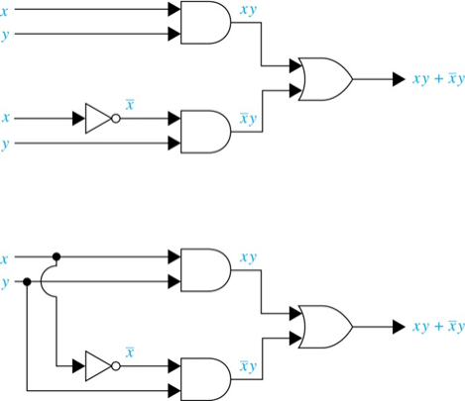
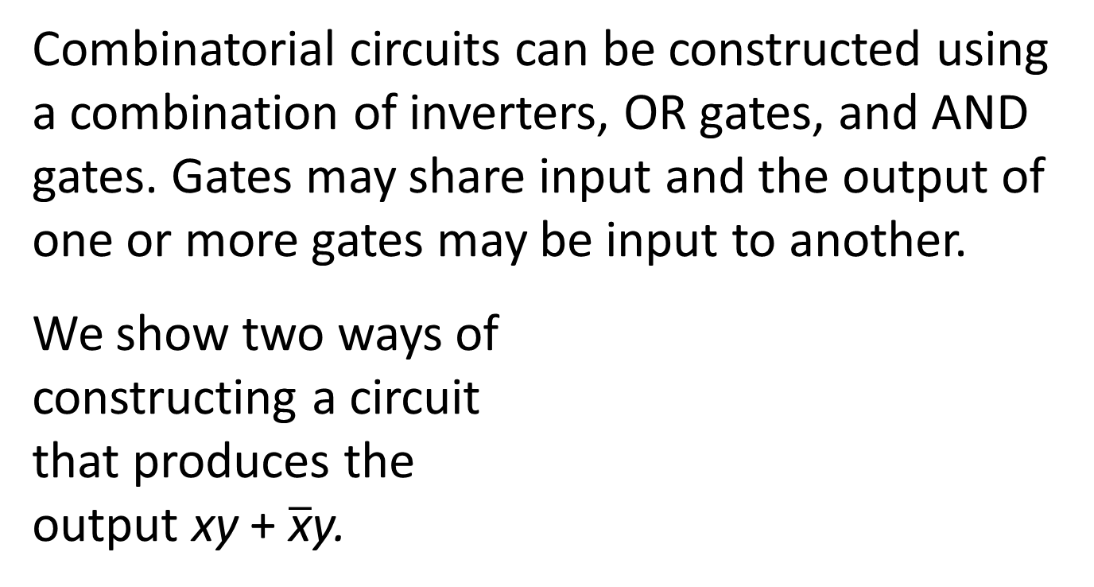
Combinations of Gates 1
Combinatorial circuits can be constructed using a combination of inverters, OR gates, and AND gates. Gates may share input and the output of one or more gates may be input to another.
We show two ways of constructing a circuit that produces the output xy + $\overline{\text{x}}$y.
Jump to long description

Slide 24
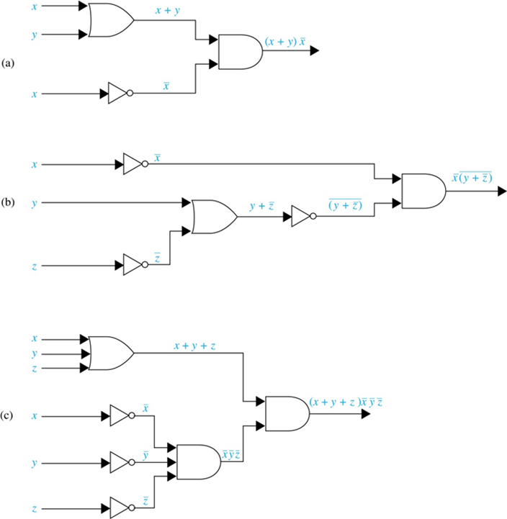
Combinations of Gates 2
Example: Construct circuits that produce these outputs
Jump to long description

Slide 25
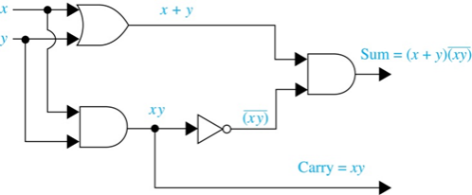
Adders 1
Logic circuits can be used to add two positive integers from their binary expansions.
The first step is to build a half adder that adds two bits, but which does not accept a carry from a previous addition.
Since the circuit has more than one output, it is a multiple output circuit.
TABLE 3 Input and Output for the Half Adder.
Input |  | Output
x | y | s | c
1 1 0 0 | 1 0 1 0 | 0 1 1 0 | 1 0 0 0
Jump to long description

Slide 26
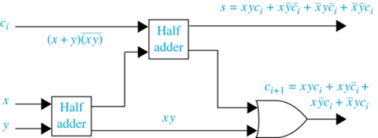
Adders 2
A full adder is used to compute the sum bit and the carry bit when two bits and a carry are added.
TABLE 3 Input and Output for the Full Adder.
Input |  | Output
x | y | c_{i} | s | c_{i + 1}
1 1 1 1 0 0 0 0 | 1 1 0 0 1 1 0 0 | 1 0 1 0 1 0 1 0 | 1 0 0 1 0 1 1 0 | 1 1 1 0 1 0 0 0
Jump to long description

Slide 27
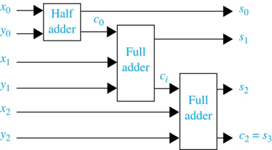
Adders 3
A half adder and multiple full adders can be used to produce the sum of n bit integers.
Example: Here is a circuit to compute the sum of two three-bit integers.
Jump to long description

Slide 28
Appendix of Image Long Descriptions

Slide 29
Logic Gates – Appendix
Top image: There are three basic logic gates. The first gate is an inverter, which has an input x and an output not x. The second gate is an OR gate, which has two inputs x and y and one output x plus y. The third gate is an AND gate, which has two inputs x and y and one output xy.
Bottom image: There are two gates. The first gate is an AND gate that has n inputs, x subscript 1, x subscript 2 and so on to x subscript n, and one output, x subscript 1, x subscript 2 and so on, x subscript n. The second gate is an OR gate that has n inputs, x subscript 1, x subscript 2 and so on to x subscript n, and one output, x subscript 1 plus x subscript 2 and so on plus x subscript n.
Jump to the image

Slide 30
Combinations of Gates 1 – Appendix
Circuit 1. There is a logical circuit consisting of 1 inverter, 2 AND gates, and 1 OR gate. The circuit has 4 inputs, 2 x and 2 y, and 1 output. The first pair of x and y is considered as an input for the first AND gate, the output is x, y. The second x input passes through the inverter with the result of not x. Together with the second y, it is considered as an input for the second AND gate. The output is not x, y. The 2 outputs, x, y and not x, y, are in turn considered as inputs for the OR gate. The output is x, y plus not x, y. Circuit 2 contains the same gates and inverter as the first circuit. There are only two initial inputs for this circuit, x and y. Each of these inputs is divided into 2 branches so that the first pair of x and y branches passes through the first AND gate. The output is x, y. The second x branch passes through the inverter with not x output and together with the second y branch passes through the second AND gate. The output is not x, y. The two outputs, x, y, and not x, y, are considered as inputs for the OR gate. The output is x, y plus not x, y.
Jump to the image

Slide 31
Combinations of Gates 2 – Appendix
Circuit A. There is a logical circuit consisting of 1 inverter, 1 AND gate, and 1 OR gate. There are 3 inputs, x, y and x. The first x together with y enters the OR gate, the output is x plus y. The second x passes through the inverter resulting in not x. Together with the output of the OR gate, it is considered as input for the AND gate. The output is left parenthesis x plus y right parenthesis not x. Circuit B. The circuit consists of 3 inverters, 1 OR gate, and 1 AND gate. There are 3 inputs, x, y, and z. x passes through the inverter and results in not x. z also passes through the second inverter and results in not z. Together with y, not z enters the OR gate. The output is y plus not z. This output, in turn, enters the third inverter, and results in not left parenthesis y plus not z right parenthesis. This output together with not x is considered as the input for the AND gate. The output is not x, not left parenthesis y plus not z right parenthesis. Circuit C. The circuit consists of 3 inverters, 2 AND gates, and 1 OR gate. There are 6 inputs, x, y, z, x, y, and z. The first set of x, y, and z enters the OR gate and results in x plus y plus z. Each of the elements of the second x, y, z set passes through the inverter, producing separately not x, not y, and not z. These 3 outputs are considered as the input for the first AND gate. The output is not x, not y, not z. This output, together with the output of the OR gate, x plus y plus z, enters the second AND gate. The output is left parenthesis x plus y plus z right parenthesis not x, not y, not z.
Jump to the image

Slide 32
Adders 1 – Appendix
There is a logical circuit consisting of 1 inverter, 2 AND gates, and 1 OR gate. There are two inputs, x and y. Each of these inputs is divided into 2 branches so that the first pair of x and y branches passes through the OR gate. The output is x plus y. The second pair of x and y branches passes through the first AND gate. The output is x, y, that is divided into 2 branches so that the first x, y passes through the inverter with the output not left parenthesis x, y right parenthesis. Together with the result of the OR gate, it is considered as an input for the second AND gate. The second x, y is the first output of the circuit, and it is labeled Carry equals x, y. The second output of the circuit is the result of the second AND gate, which is Sum equals left parenthesis x plus y right parenthesis, not left parenthesis x, y right parenthesis.
Jump to the image

Slide 33
Adders 2 – Appendix
There is a logical circuit consisting of 1 OR gate and 2 Half adders. The circuit has 3 inputs c subscript i, x, y. Input c subscript i is left parenthesis x plus y right parenthesis not left parenthesis x, y right parenthesis. C subscript i is the first input of the first half adder. A pair of x and y is the input of the second half adder. The first output of the second Half adder is the second input of the first Half adder. And the second output is x, y, that goes to the OR gate. The first output of the first Half adder is the first output of the circuit, that is labeled s equals x, y, c subscript i plus x, not y, not c subscript i plus not x, y, not c subscript i plus not x, not y, c subscript i. The second output of the first Half adder goes to the OR gate. The result of the OR gate is the second output of the circuit, that labeled c subscript i plus one equals x, y, c subscript i plus x, y, c subscript i plus x, not y, c subscript i plus not x, y, c subscript i.
Jump to the image

Slide 34
Adders 3 – Appendix
There is a logical circuit consisting of 1 Half adder and 2 Full adders. The circuit has 6 inputs. x subscript 0 to x subscript 2, y subscript 0, and y subscript 1. And it has 4 outputs. The first set of x subscript 0 and y subscript 0 goes to the first Half adder, the first output of which is s subscript 0 and it is the first output of the circuit. And the second output of the first Half adder is c subscript 0, it is considered as an input for the first Full adder. The second set of x subscript 1 and y subscript 1 goes to the first Full adder, the first output of which is s subscript 1 and it is the second output of the circuit. And the second output of the first Full adder is c subscript i that is considered as an input for the second Full adder. The third set of x subscript 2 and y subscript 2 goes to the second Full adder. The outputs of the second Full adder are s subscript 2 and c subscript 2 equals s subscript 3, that are the third and the fourth outputs of the circuit.
Jump to the image

